Slide 1
Elementary Components
Analog Transistor symbols:
NMOS
S
PMOS
D
G
B
G
B
V_{S} < V_{D}
D
V_{S} > V_{D}
S
V_{GS}
V_{DS}
Bulk -> V_{SS}
V_{DS}
Bulk -> V_{DD}
V_{GS}
October 2007
A. Kaiser - CMOS Components

Slide 2
MOSFET Transistor
V_{G}
V_{S}
V_{D}>V_{G}-V_{T}
n+
n+
p-
V_{B}
L
W
w_{s}
w_{d}
October 2007
A. Kaiser - CMOS Components

Slide 3
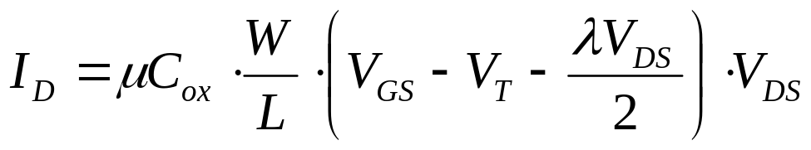
I_{D} – V_{G} caracteristic
V_{DS}<< (fixed)
Weak inversion
Moderate inversion
Strong inversion
I_{D}
V_{GS}
Log I_{D}
Réduction de mobilité (µ)
V_{T}
V_{G}
V_{T}
V_{G}
In triode:
October 2007
A. Kaiser - CMOS Components

Slide 4
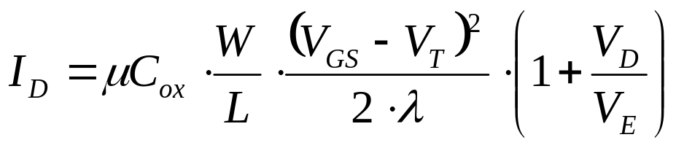
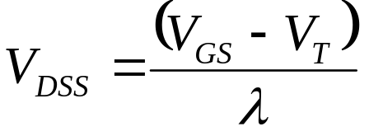
I_{D} – V_{D} caracteristic
V_{DSS}
I_{D}
V_{GS4}
V_{DS}
V_{GS3}
V_{GS}
V_{GS2}
V_{GS1}
-V_{E}
V_{D}
In saturation:
D-S saturation voltage:
October 2007
A. Kaiser - CMOS Components

Slide 5
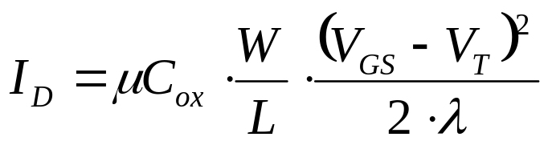
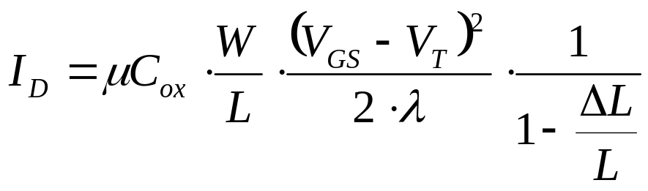
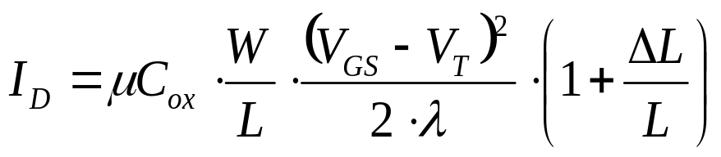
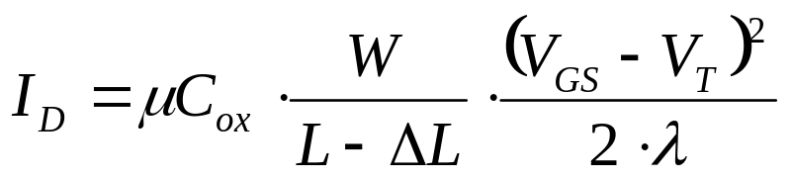
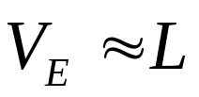
Early Effect
V_{G}
V_{G}
V_{D}+ΔV
V_{D}
V_{D}>V_{G}-V_{T}
n+
n+
n+
n+
p-
p-
ΔL
October 2007
A. Kaiser - CMOS Components

Slide 6
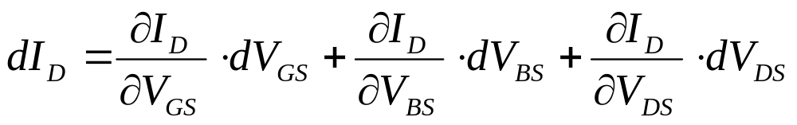
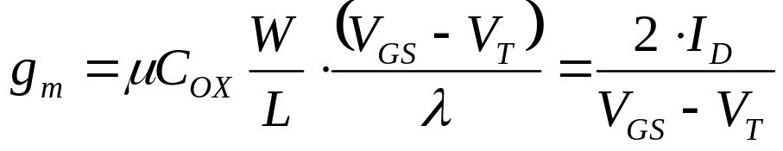

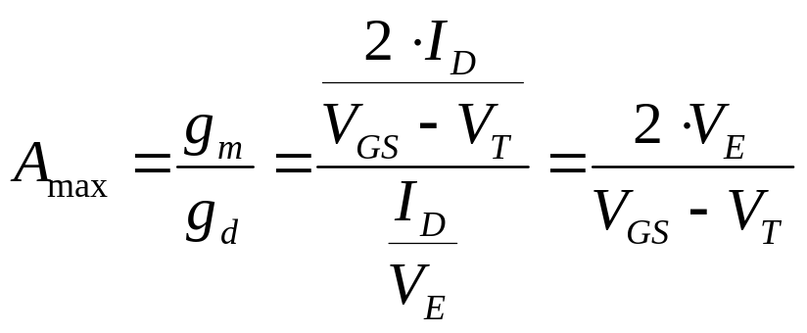
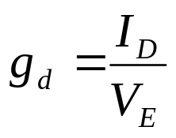
Small Signal Model
{
{
{
g_{m}
g_{mb}
g_{d}
October 2007
A. Kaiser - CMOS Components

Slide 7
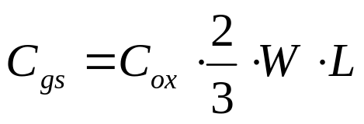
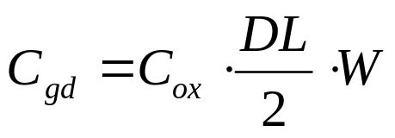
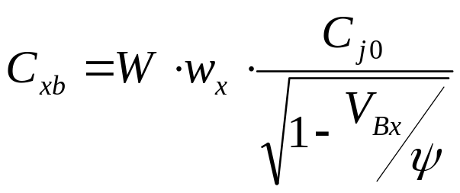
MOSFET Capacitances
V_{G}
DL/2
V_{S}
C_{gd}
V_{D}>V_{G}-V_{T}
C_{gs}
n+
n+
C_{db}
p-
C_{sb}
V_{B}
(saturation)
L
W
x=s ou d
w_{s}
w_{d}
October 2007
A. Kaiser - CMOS Components

Slide 8
Complete Small Signal Model
v_{g}
C_{gs}
C_{gd}
V_{D}
g_{m} · v_{gs}
V_{G}
V_{B}
v_{s}
v_{d}
g_{mb} · v_{bs}
V_{S}
C_{sb}
g_{d} · v_{ds}
C_{db}
v_{b}
October 2007
A. Kaiser - CMOS Components

Slide 9
Practical Small Signal Model
v_{g}
C_{gs}
C_{gd}
V_{D}
g_{m} · v_{gs}
V_{G}
v_{d}
g_{mb} · v_{bs}
C_{sb}
g_{d} · v_{ds}
C_{db}
October 2007
A. Kaiser - CMOS Components

Slide 10
Practical Small Signal Model (2)
Very small, only relevant in HF circuits
V_{D}
C_{gd}
v_{d}
v_{g}
g_{m}·v_{gs}
V_{G}
g_{d}
C_{gs}
C_{db}
V_{S}
v_{s}
Lumped into C_{L} on input/output node
October 2007
A. Kaiser - CMOS Components

Slide 11
Minimal Small Signal Model
V_{D}
v_{d}
v_{g}
g_{m}·v_{gs}
V_{G}
g_{d}
v_{gs}
v_{ds}
V_{S}
v_{s}
October 2007
A. Kaiser - CMOS Components

Slide 12
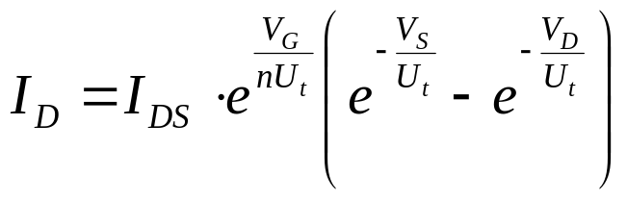
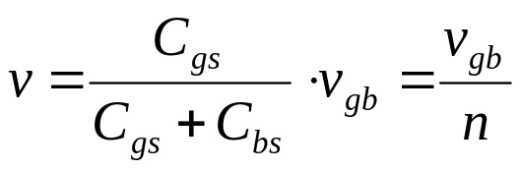
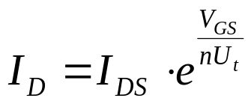
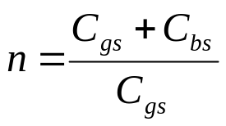
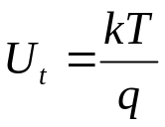
Weak Inversion Operation
V_{G}
V_{G}
V_{G}
V_{D}
V_{D}
V_{D}
C_{gs}
C_{bs}
n+
n+
n+
n+
n+
n+
p-
p-
p-
V_{B}
Surface potential v controlled by
if V_{S}=V_{B}
and V_{D} > qq nU_{t}
October 2007
A. Kaiser - CMOS Components

Slide 13
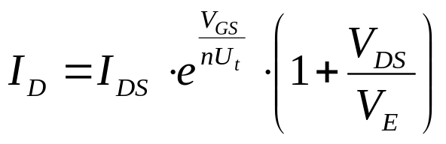
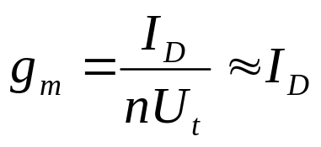

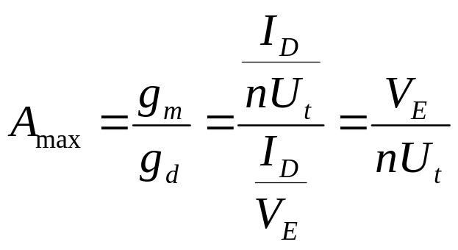
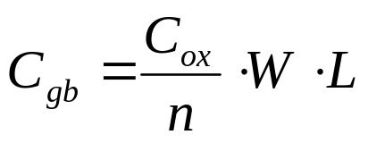
Small Signal Model
Weak inversion
Moderate inversion
Strong inversion
Log I_{D}
Slope 1/nU_{t}
V_{T}
V_{G}
October 2007
A. Kaiser - CMOS Components

Slide 14
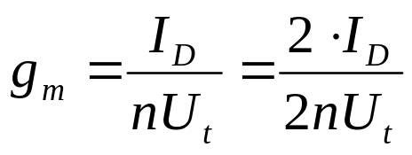
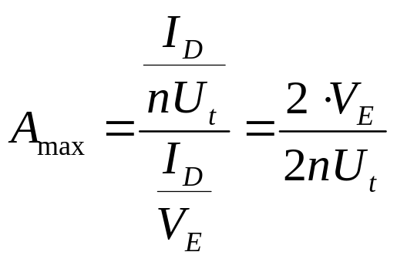
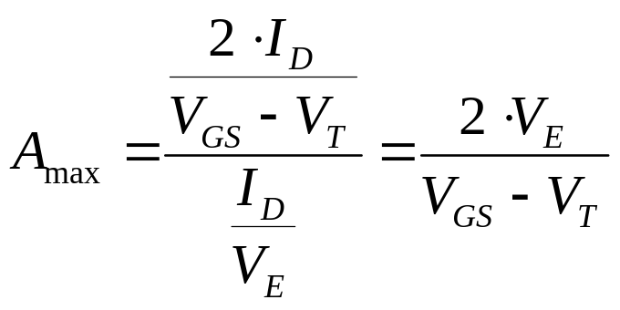
Comparison WI - SI
WI
SI
October 2007
A. Kaiser - CMOS Components

Slide 15
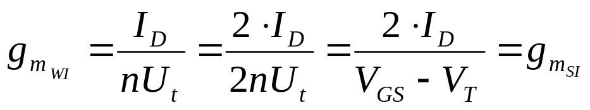


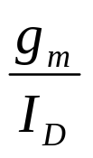
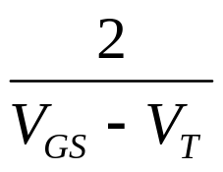
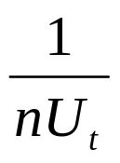


WI – SI junction
WI limit !
Practical values:
U_{t} = 27mV (T = 25°C)
n = 1.5
2nU_{t} ≈ 80mV
October 2007
A. Kaiser - CMOS Components

Slide 16

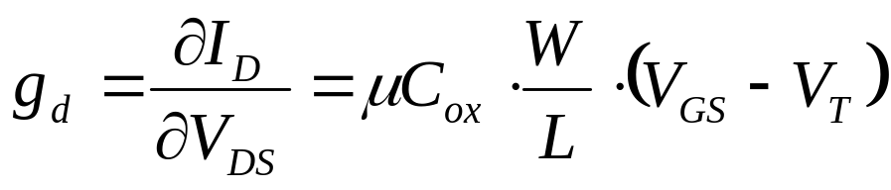
MOSFET as a Switch
V_{G}= VDD
V_{G}=0
V_{D}
V_{S}
V_{D}=V_{S}
V_{S}
V_{D}<V_{G}-V_{T}
n+
n+
n+
n+
p-
p-
(triode region)
October 2007
A. Kaiser - CMOS Components

Slide 17
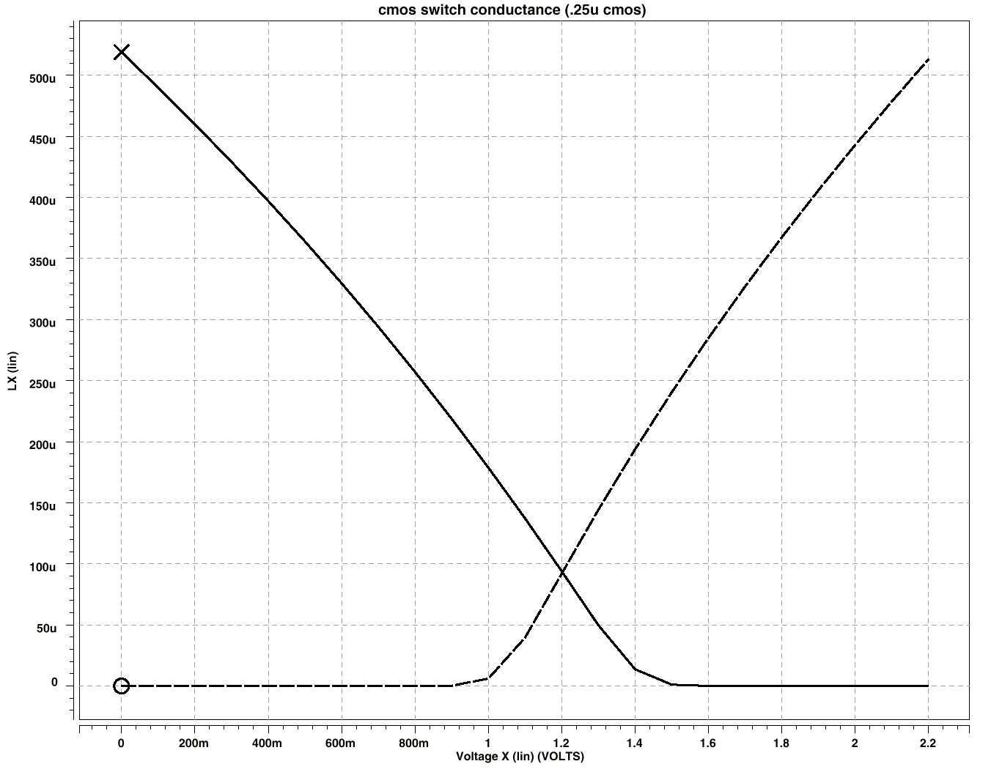
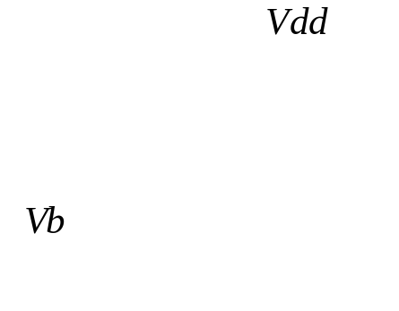
Switch Conductance
gds
NMOS
PMOS
V_{TP}
V_{TN}
Rswitch < 5kΩ
Vb
October 2007
A. Kaiser - CMOS Components

